Slide 1
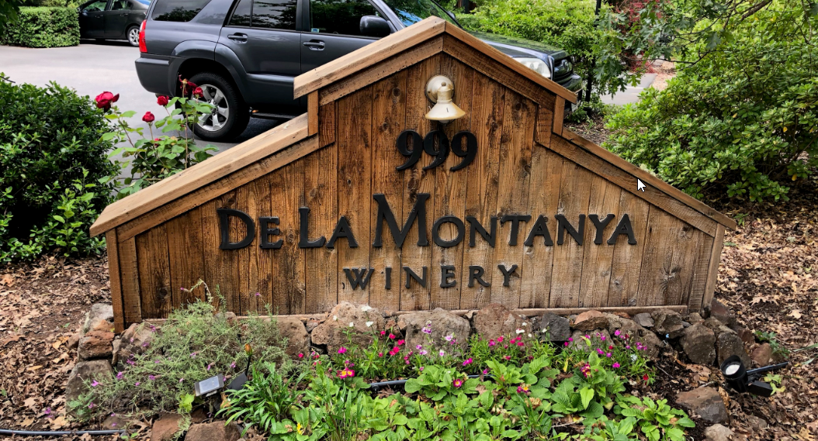
De La Montanya Winery Amendment of Conditions
Washoe County Board of Adjustment
January 6, 2022
WAC21-0008

Slide 2
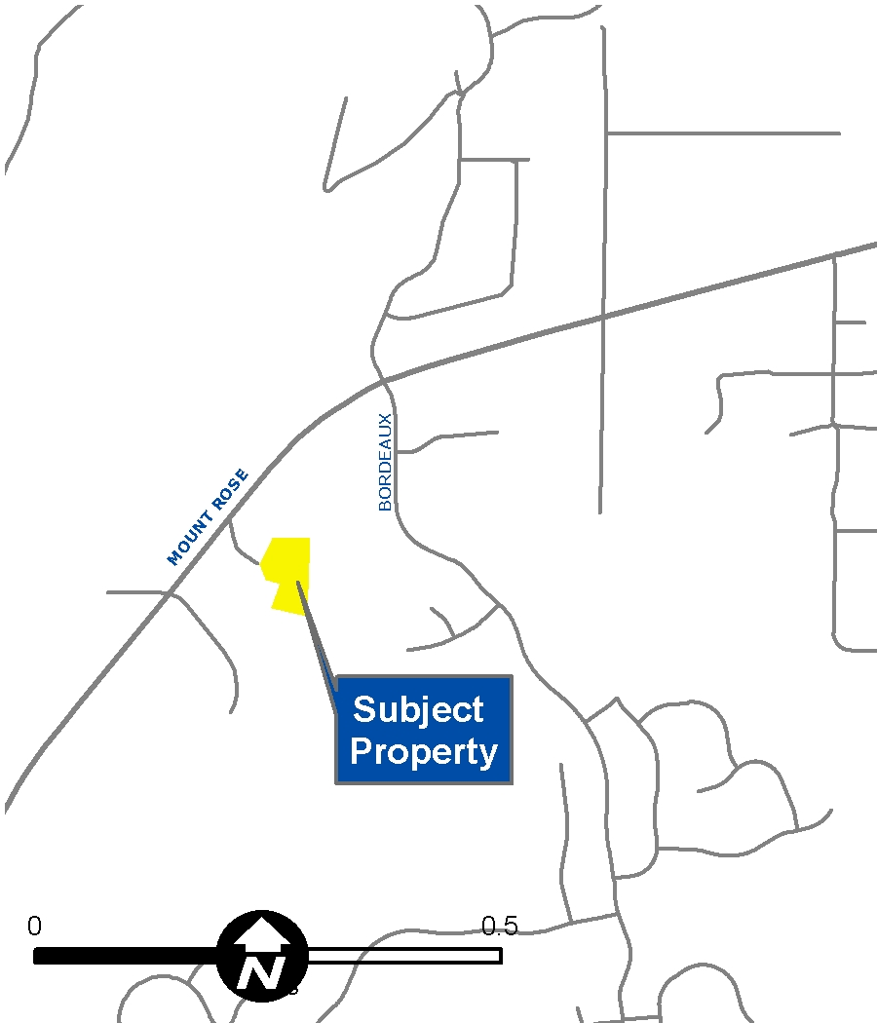
Vicinity Map
16435 and 16445 Bordeaux Drive
2 Parcels
2.02 acres
Low Density Suburban

Slide 3
Original Request
Administrative permit for a winery use in the Low Density Suburban Regulatory Zone
4,199 sq ft building
Production area is 1,170 sq ft
Tasting and barrel rooms will be 2,400 sq ft total
No Special Events (Weddings, etc)
1 acre of vineyard

Slide 4
Analysis
There are NO CHANGES to the Administrative Permit.
The site is proposed to have a boutique winery (AP) with crop production (A)

Slide 5
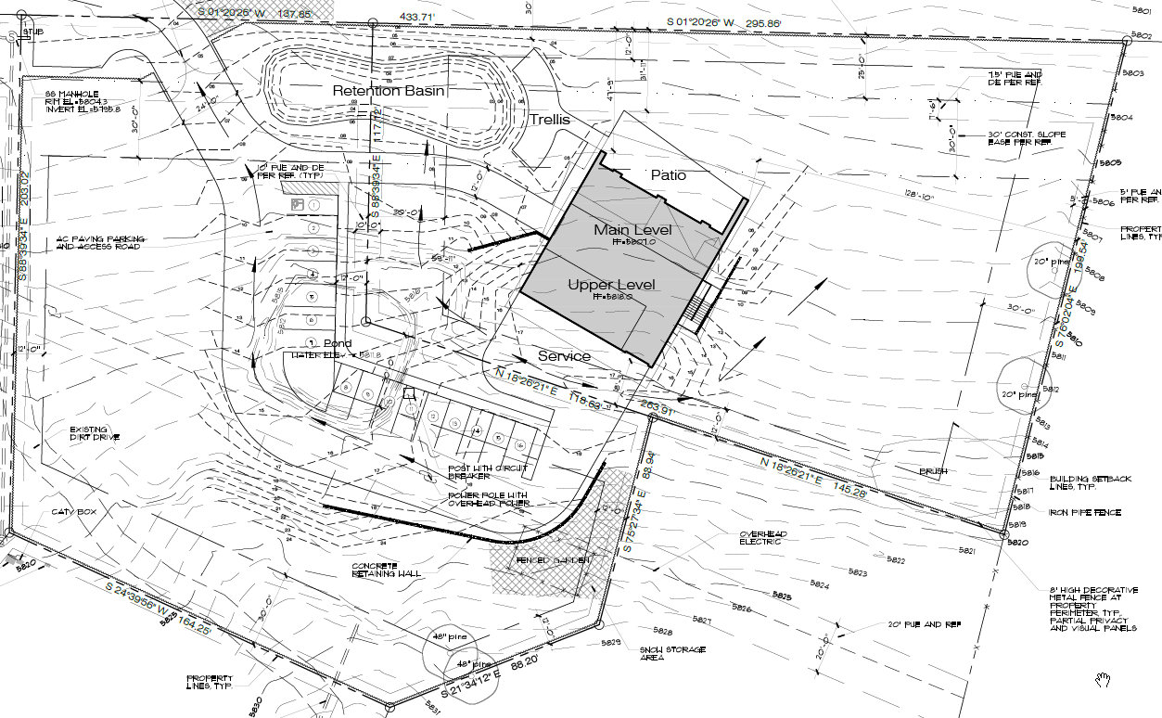
Site Plan

Slide 6
Update Request
Applicant is requesting a 2-year extension of time due to the Covid-19 pandemic.
It has generally been the practice for Washoe County to grant most projects the first requested Extension of Time

Slide 7
Possible Motion
APPROVE WITH CONDITIONS: I move that, after giving reasoned consideration to the information contained in the staff report and information received during the public hearing, the Washoe County Planning Commission approve Amendment of Conditions Case Number WAC21-0008 for Dennis De La Montanya, with the amended conditions of approval included as Exhibit A to this matter, having made all five findings in accordance with Washoe County Code Section 110.808.25

